Slide 1
Educational White Board
By:
Priyank P. Bambharolia (090280107036)
Radhika J. Thumar (090280107056)
Shraddha A. Padariya (090280107013)

Slide 2
Project Need & Idea
Presently teaching is done by black or white board by professor or tutor.
If class is large than it is possible that students sitting at the last rows can’t see content of board. Classroom capacity is also a constraint. If the strength of students increases than the classroom capacity then professor is not able to manage the lecture.
Mostly students who are far from the board cannot see the diagrams clearly.

Slide 3
Project Need & Idea
EDUCATIONAL WHITE BOARD provides solution for this problem. By using this system a student can see the diagram which is drawn by the teacher right on their computer screens. System also creates an environment in which students can gain knowledge easily.
A student can also save the diagram for future reference

Slide 4
System Description
The EDUCATIONAL WHITE BOARD creates a virtual “white board” where a teacher can draw the diagrams on his/her computer and students can see them in their own computers easily and reliably.
This System is designed in such a way that the student i.e. client can log on in the server. Teacher can send text files to students, too. I.e. Clients have his or her own login name and password, which help them to get connected with the server.

Slide 5
Goals Of Implementation
To support live on-line classes for distance learning and remote education.
To pool academic resources there by improving access to advanced educational experiences.
To improve the quality and effectiveness of education by collaborative learning and teaching process.
To increase and improve the accessibility of educational resources to the persons with disabilities.

Slide 6
Environmental Characteristics
Hardware:
Server side:
i 3 processor or above it
4GB RAM
Client side:
Core 2 duo or above it
1 GB RAM

Slide 7
Environmental Characteristics
Software :
Server side :
Windows 7 (Recommended)
MS SQL server
Client side :
Windows XP or above

Slide 8
Technology Used
Front End
Java SE
Swing
RMI
JDBC
Socket Programming

Slide 9
Technology Used
Back end
My SQL
Tools
NetBeans

Slide 10
Process Model
When an incremental model is used, the first increment is often a core product. Basic requirements are addressed, but many supplementary features remain undelivered. The core product is used by the customer . As a result of use or evaluation, a plan is developed for the next increment. It addresses the modification of the core product to better meet the needs of the customer and the delivery of additional functionality. This process is repeated in each increment, until the complete product is produced.

Slide 11
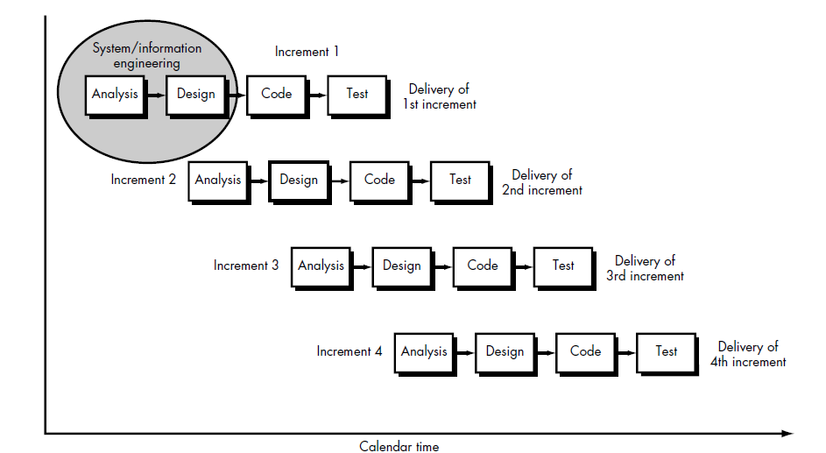
Process Model

Slide 12
Activity Diagram- Admin

Slide 13
Activity Diagram- Teacher

Slide 14
Activity Diagram- Student

Slide 15
DFD - 0

Slide 16
DFD – 1_Admin

Slide 17
DFD – 1_Teacher

Slide 18
DFD – 1_Student

Slide 19
Sequence Diagram

Slide 20
ER Diagram

Slide 21
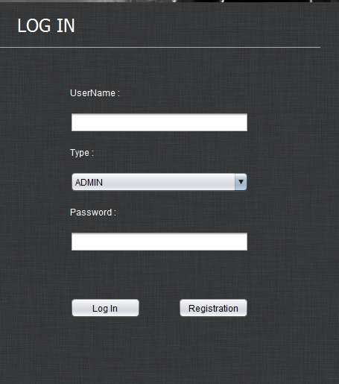
Login Form

Slide 22
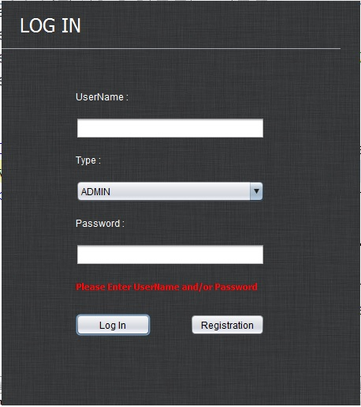
Login Form- Blank

Slide 23
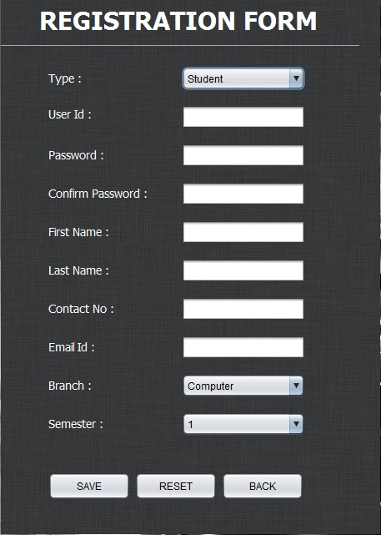
Registration form - Student

Slide 24
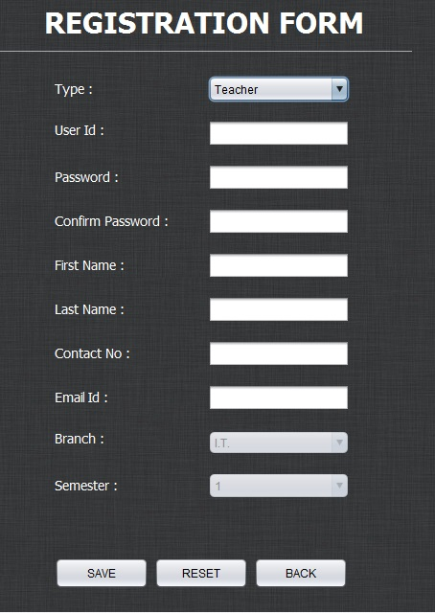
Registration form - Teacher

Slide 25
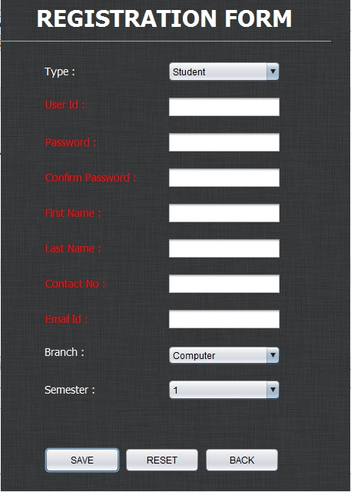
Registration blank

Slide 26
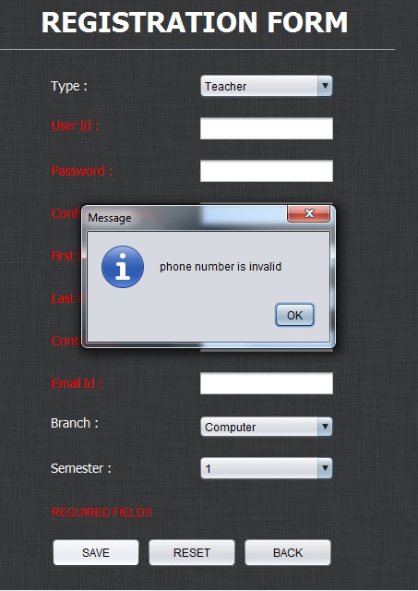
Registration phone no

Slide 27
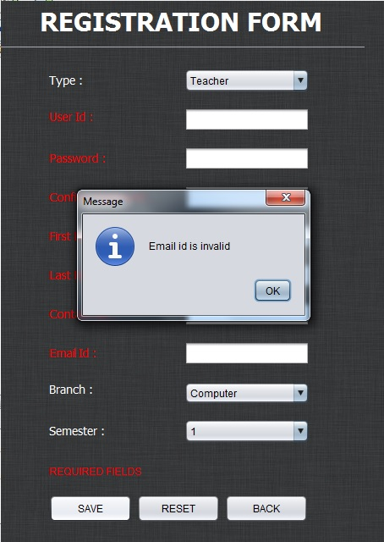
Registration Email

Slide 28
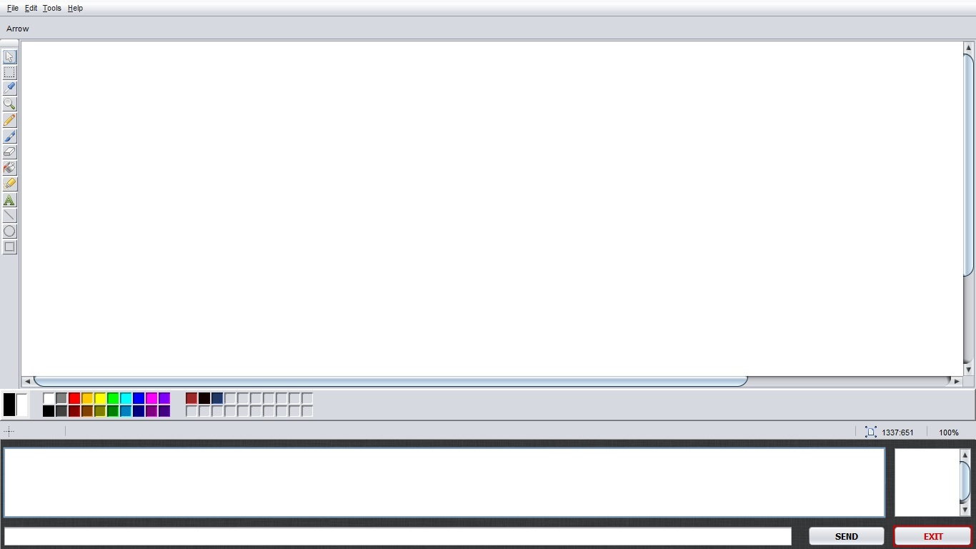
Teacher Main Window

Slide 29
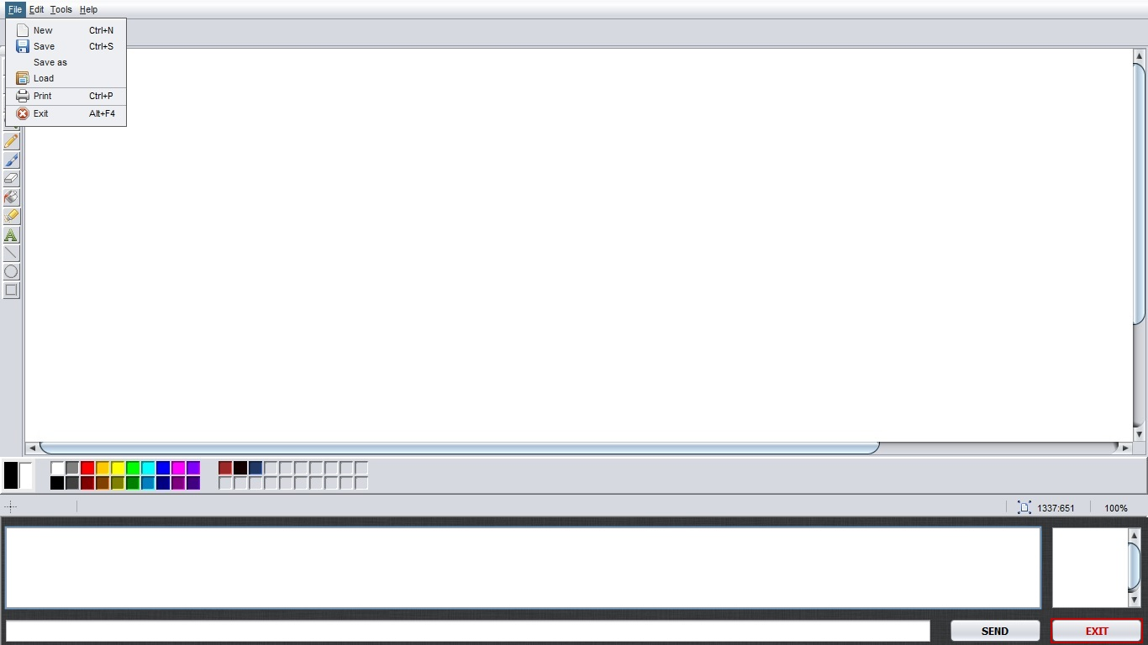
Teacher File Menu

Slide 30
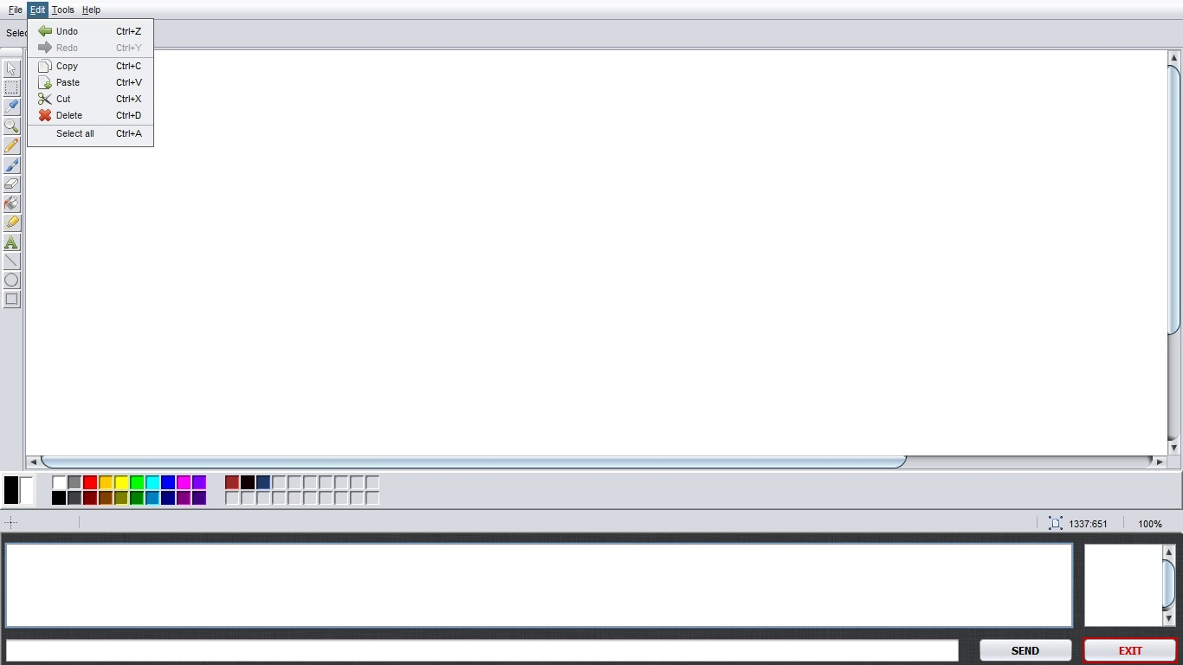
Teacher Edit Menu

Slide 31
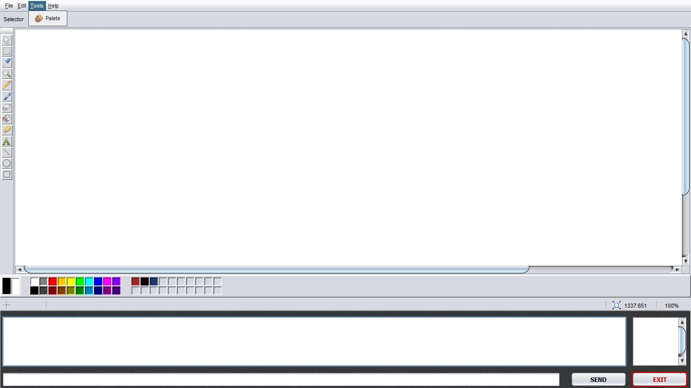
Teacher Tools Menu

Slide 32
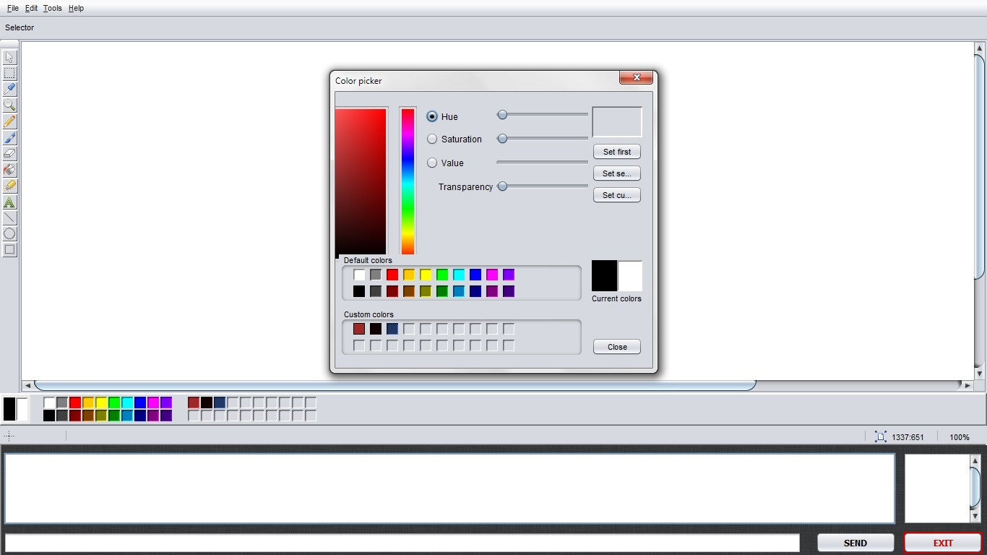
Teacher Colour Menu

Slide 33
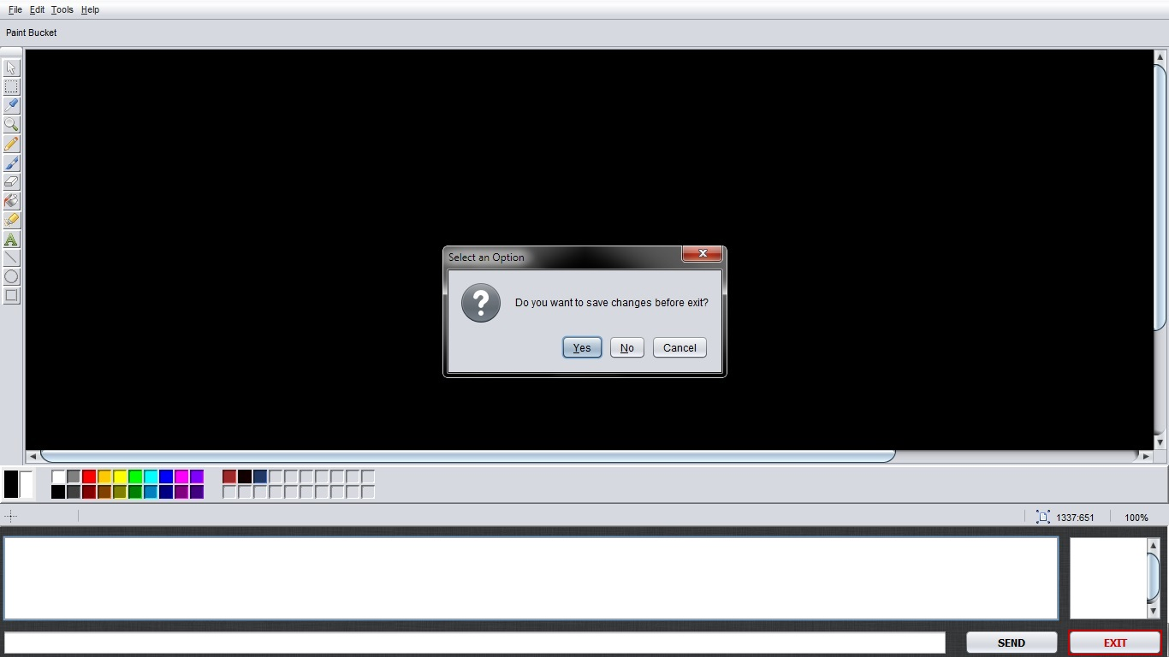
Save On Exit

Slide 34
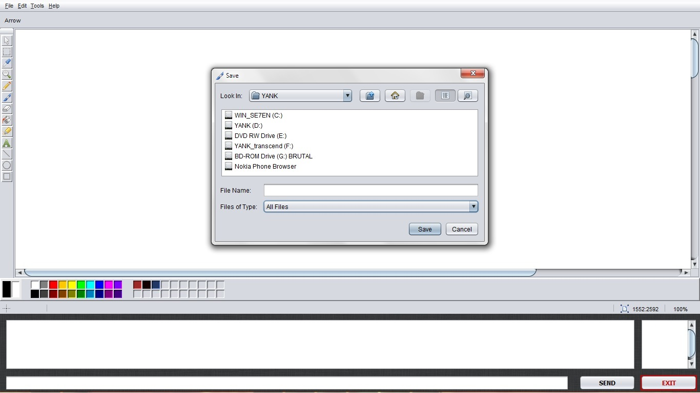
Save File Menu

Slide 35
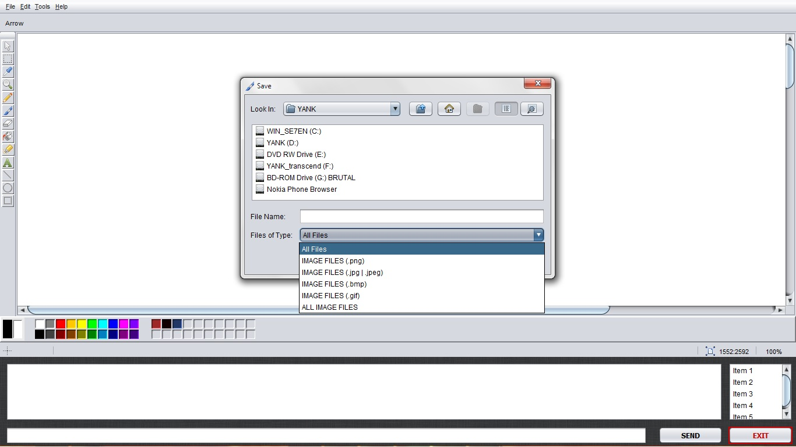
Save File Menu - File choose

Slide 36
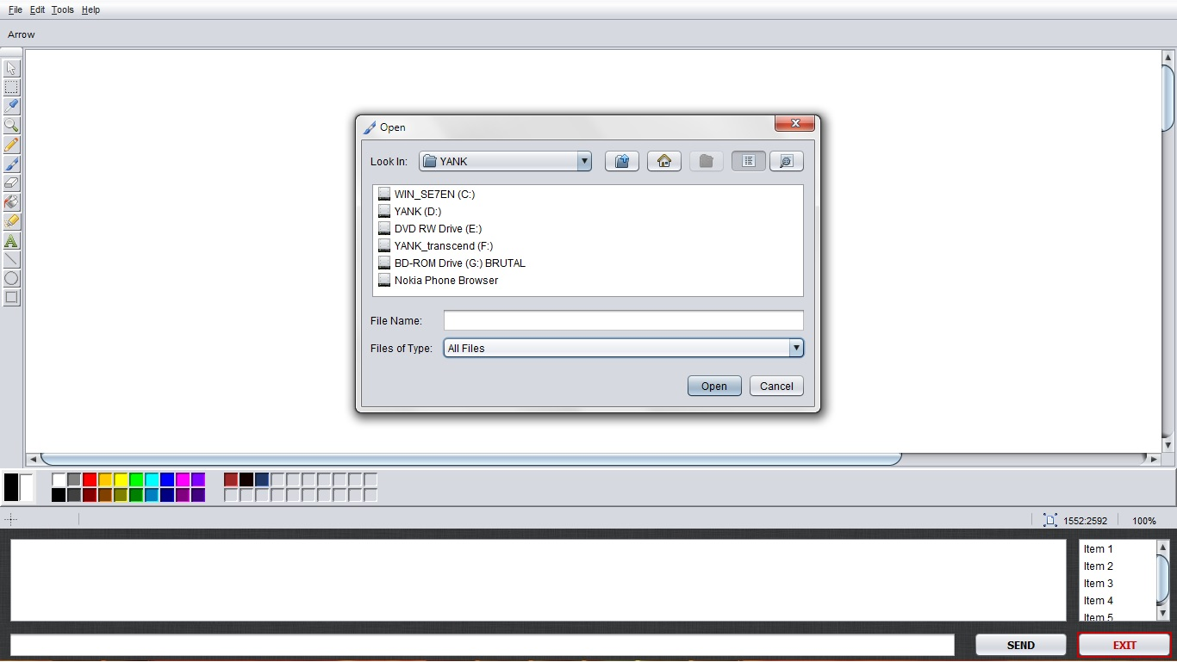
Open File Menu

Slide 37

Open File Menu - File chooser

Slide 38
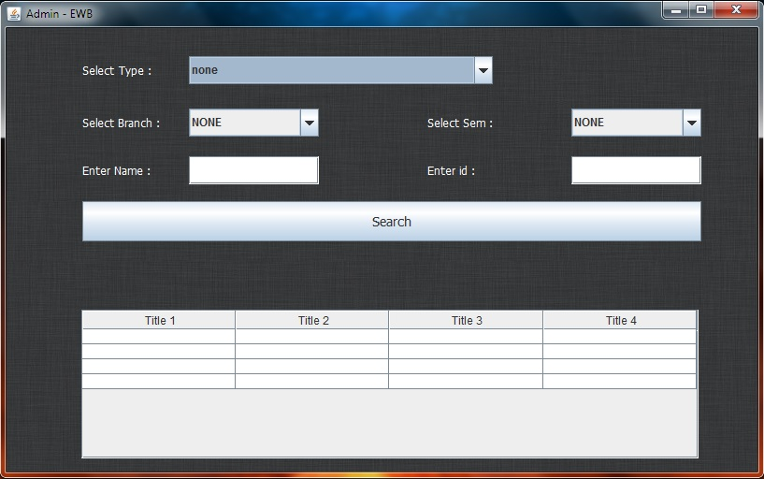
Admin Window

Slide 39
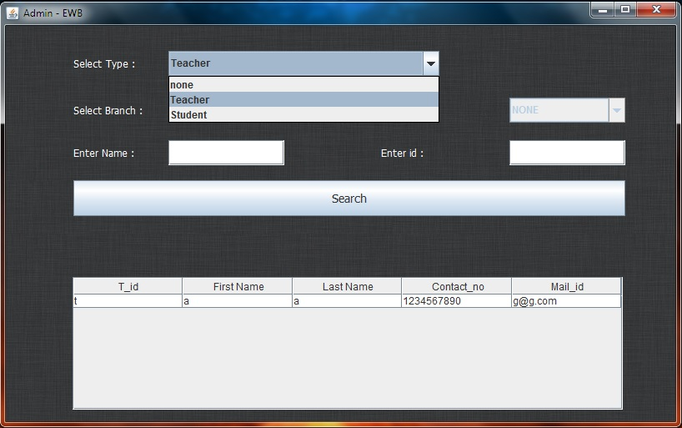
Admin Window

Slide 40
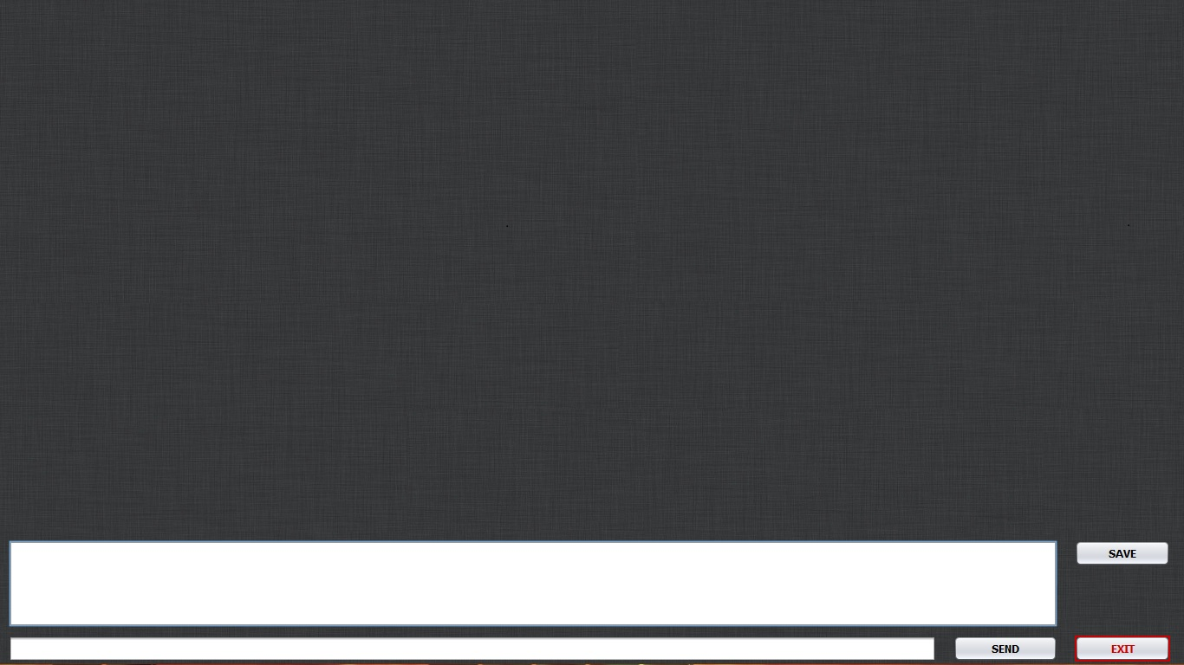
Student Window

Slide 41
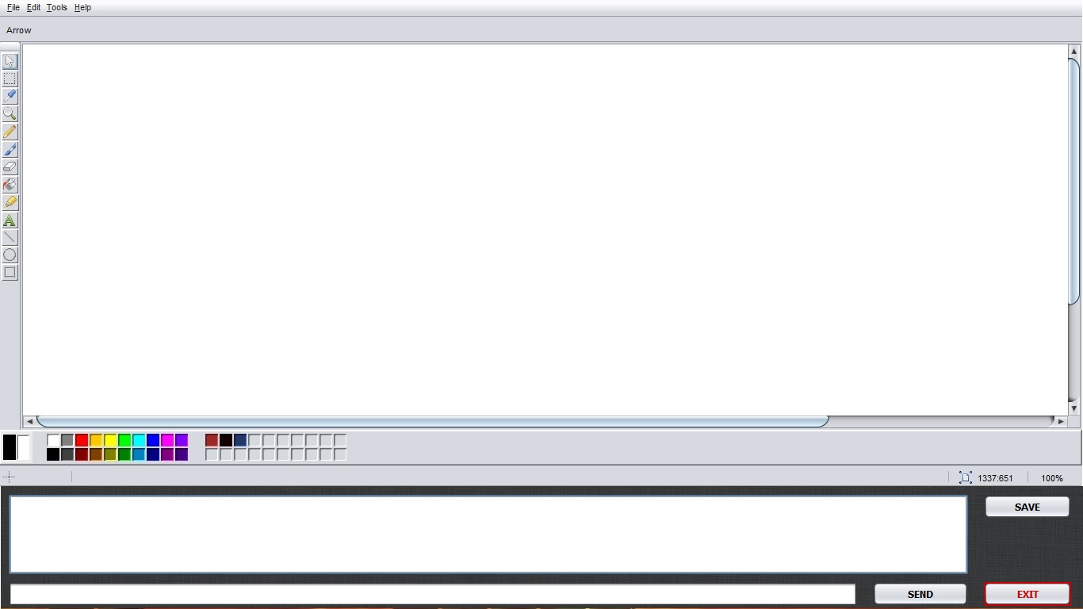
Student Window (Shared screen)

Slide 42
Limitation & Future Extension
It uses static IP address we can extend it to dynamic IP address level.
It is limited to classroom but we can extend it to university level by providing wireless network and dynamic IP address.
It shares texts and graphics but we can extend it to audio and video sharing.

Slide 43
Conclusion
Educational White Board is kind of system by which tutor can share graphics and text with students thus it overcomes the drawbacks of conventional Black Board

Slide 44
References
Software Engineering, Eighth Edition, Somerville, Pearson
Oriented Modelling and Design with UML second edition by Michael Blaha and James Ram Baugh.
Headfirst learning Java & Headfirst JSP & Servlet by Bret Bates & Kathy Sierra.
Software Engineering - a practitioner's approach by Roger Pressman.
Java Server Programming J2Ee 1.4 Ed. Black Book by Dreamtech Press.

Slide 45
THANK YOU

